Slide 1


Slide 2



Health Literacy
The degree to which individuals have the capacity to obtain, process, and understand basic health information and services needed to make appropriate health decisions.
Berkman, Davis, and McCormack. Health literacy: What is it? J Health Comm. 2010; 15:9–19.
Notes:
Source: Berkman, Davis, and McCormack. Health literacy: What is it? J Health Comm. 2010; 15:9–19.

Slide 3
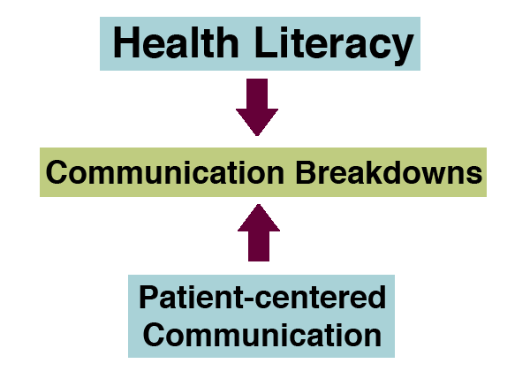
Ridpath, Larson, and Greene, Can Integrating Health Literacy into the Patient-centered Medical Home Help us Weather the Perfect Storm?, 2012, pg. 2
Notes:
Ridpath, Larson, and Greene, Can Integrating Health Literacy into the Patient-centered Medical Home Help us Weather the Perfect Storm?, 2012, pg. 2

Slide 4
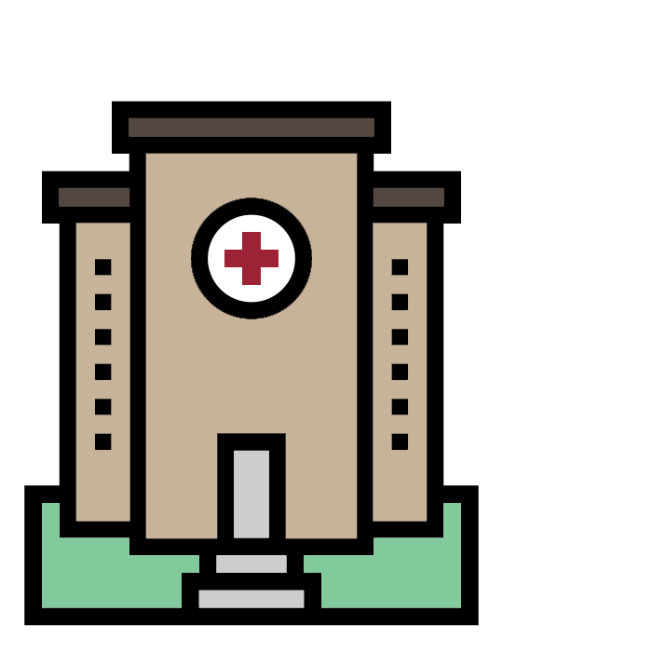
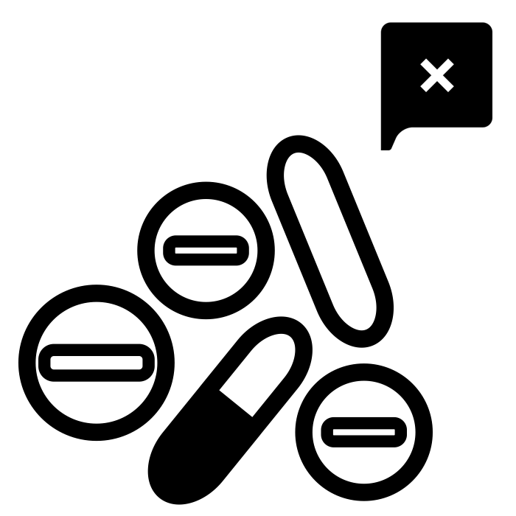

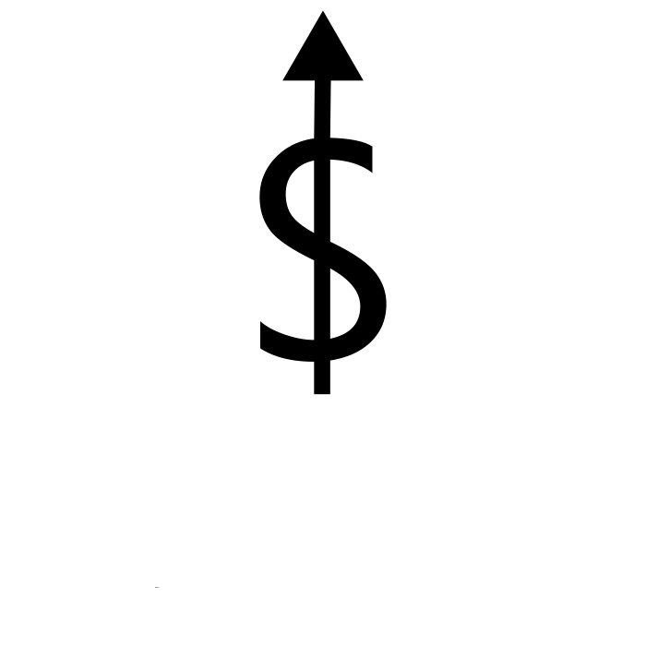
Inadequate Health Literacy is Associated With
Unnecessary ER visits
Skipped screenings
& shots
Medication errors
High healthcare cost
PCMH support screener package, 2017, pg. 2
Notes:
PCMH support screener package, 2017, pg. 2

Slide 5


US Adults and Health Literacy
37% Low health literacy
90% Feel it’s useful for the doctor to know they struggle with health information
PCMH support screener package, 2017, pg. 2
Notes:
PCMH support screener package, 2017, pg. 2

Slide 6
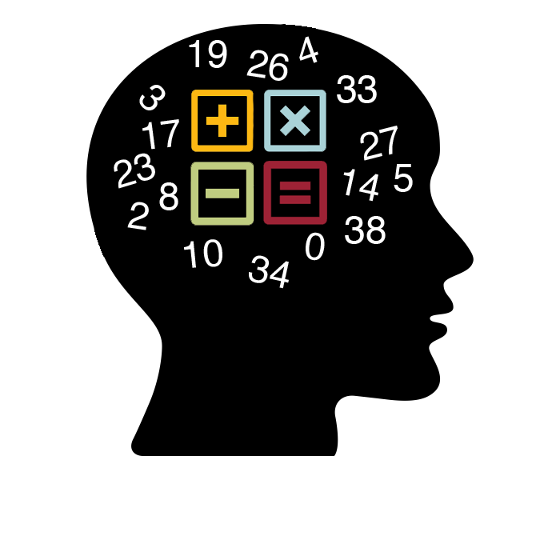


What Does This Mean?
Document
Prose
Quantitative
National Center for Education Statistics. The health literacy of America's adults: Results from the 2003 National Assessment of Adult Literacy. Washington, DC: U.S. Department of Education; 2006.
Notes:
The citation for this survey is: National Center for Education Statistics. The health literacy of America's adults: Results from the 2003 National Assessment of Adult Literacy. Washington, DC: U.S. Department of Education; 2006.
locating easily identifiable information in short, commonplace prose texts
locating easily identifiable information and following written instructions in simple documents (e.g., charts or forms)
locating numbers and using them to perform simple quantitative operations (primarily addition) when the mathematical information is very concrete and familiar
Below Basic indicates no more than the most simple and concrete literacy skills. Adults at the Below Basic level range from being nonliterate in English to having the abilities listed (in slide)

Slide 7
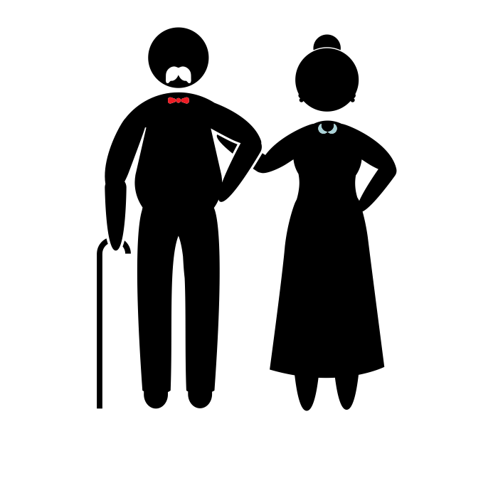


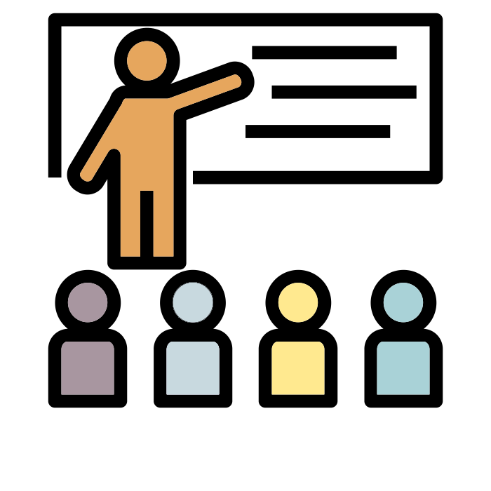
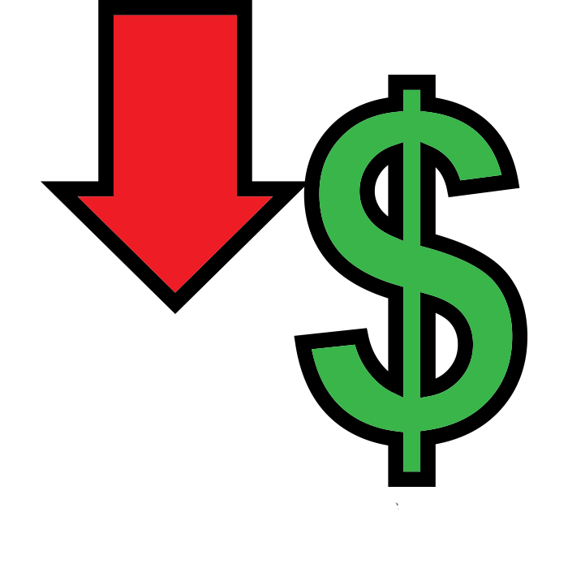
Who Struggles With Limited Health Literacy?
Low education
Low income
Minority race
Advanced age
Chronic disease status
PCMH support screener package, 2017, pg. 2
Notes:
Source: PCMH support screener package, 2017, pg. 2

Slide 8
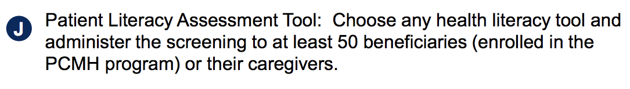
PCMH Activities Tracked for Practice Support
PCMH Program Policy Addendum, 2018, pg 13.
Notes:
PCMH Program Policy Addendum, 2018, pg 13.

Slide 9




Patient Behavior
Filling Asthma
Medication
ADHD Follow-up
Visits
Wellness Visit
Eye Exam
Ridpath, Larson, and Greene, Can Integrating Health Literacy into the Patient-centered Medical Home Help us Weather the Perfect Storm?, 2012, pg. 3
Notes:
Source: Ridpath, Larson, and Greene, Can Integrating Health Literacy into the Patient-centered Medical Home Help us Weather the Perfect Storm?, 2012, pg. 3

Slide 10
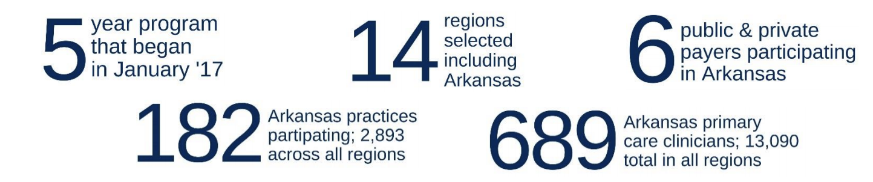
PCMH Metrics
ACHI CPC+ Fact Sheet, 2017, pg. 1
Notes:
ACHI CPC+ Fact Sheet, 2017, pg. 1

Slide 11
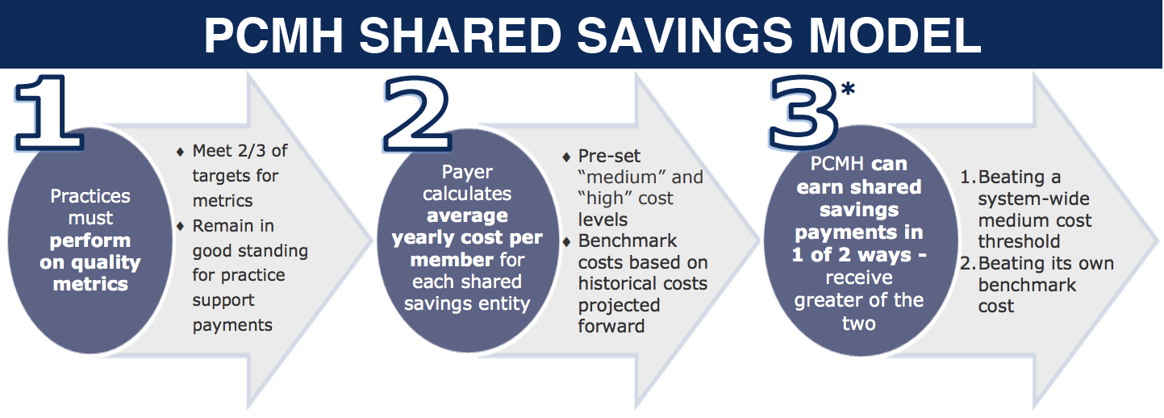
*Earning shared savings eligibility
ACHI Patient-centered Medical Homes, 2015, pg. 2
Notes:
ACHI Patient-centered Medical Homes, 2015, pg. 2
*Earning shared savings eligibility: Eligibility requires a minimum of 5,000 Medicaid patients who have been attributed for at least six months. Since few individual practices have sufficient numbers of patients to reach this threshold, Arkansas Medicaid allows two practices or multiple providers with the same tax identification number to pool their patients to achieve the 5,000 patient minimum as long as the pooled practices are accountable for their combined quality metrics and attributes of a medical home. In 2015, a statewide default pool will provide another means of practice entry into shared savings.

Slide 12

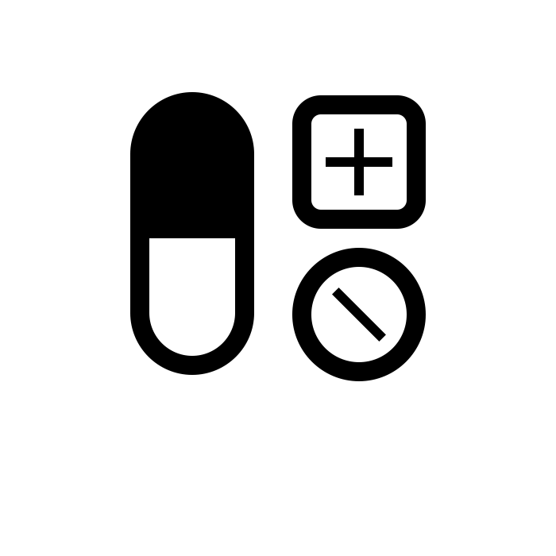
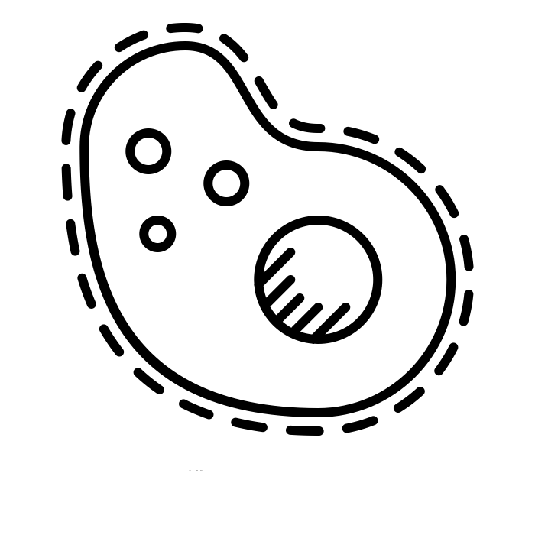
Why Does It Matter?
Patients with low health literacy are:
More Likely to…
Miss follow-up visits
Less Likely to…
Take preventative measures
Adhere to medication regimen
Manage chronic illnesses
Ridpath, Larson, and Greene, Can Integrating Health Literacy into the Patient-centered Medical Home Help us Weather the Perfect Storm?, 2012, pg. 2 - 3
Notes:
Source: Ridpath, Larson, and Greene, Can Integrating Health Literacy into the Patient-centered Medical Home Help us Weather the Perfect Storm?, 2012, pg. 2 - 3

Slide 13
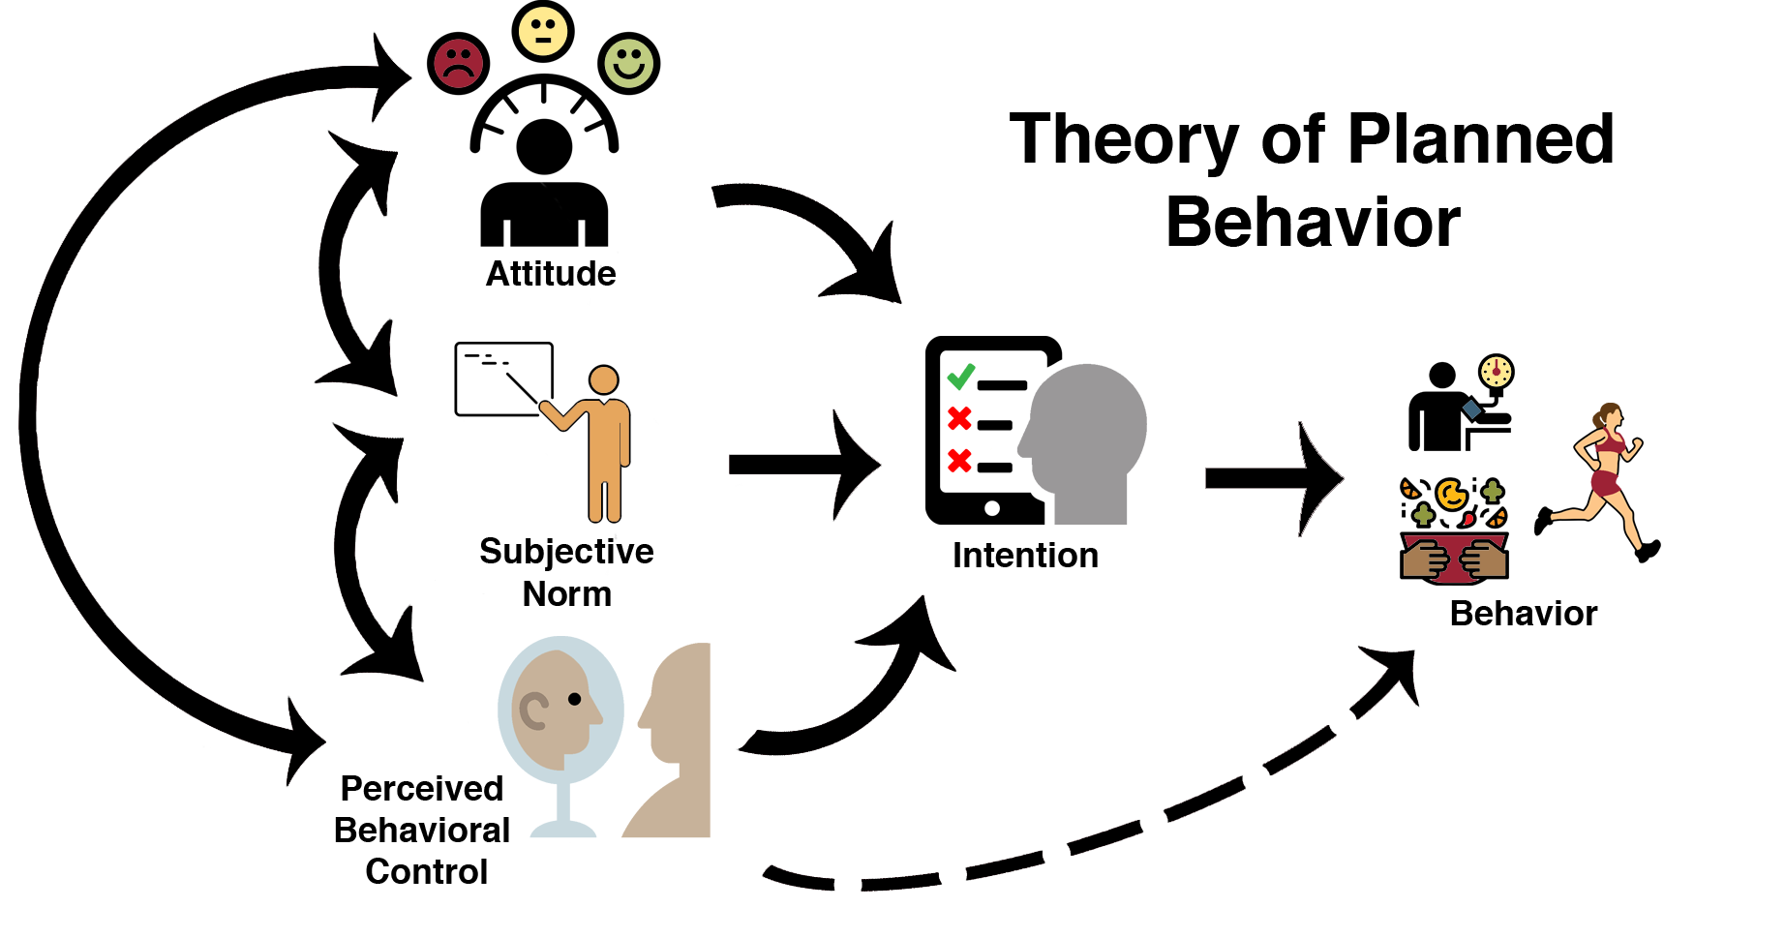
Ajzen, I. (1991). The theory of planned behavior. Organizational Behavior and Human Decision Processes, 50, p. 179-211.
Notes:
Ajzen, I. (1991). The theory of planned behavior. Organizational Behavior and Human Decision Processes, 50, p. 179-211.

Slide 14
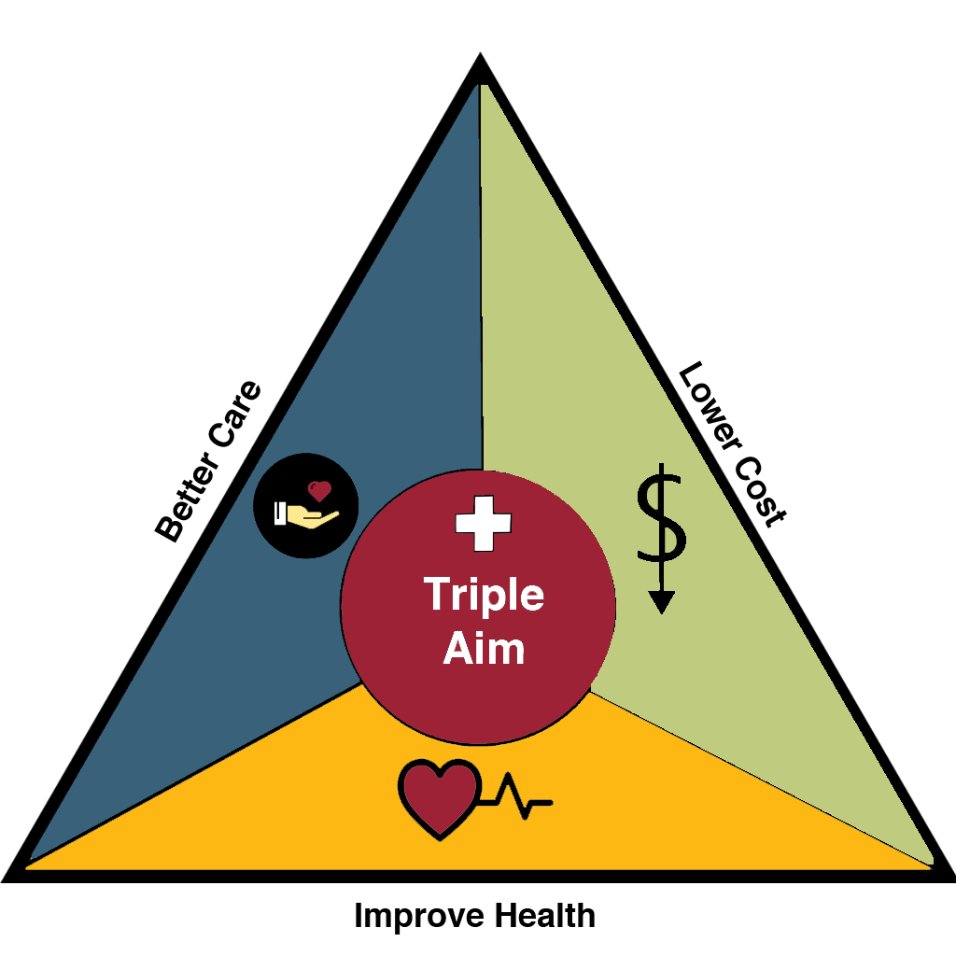
Institute for Healthcare Improvement (IHI), 2018, http://www.ihi.org/Engage/Initiatives/TripleAim/Pages/default.aspx
Notes:
Institute for Healthcare Improvement (IHI), 2018, http://www.ihi.org/Engage/Initiatives/TripleAim/Pages/default.aspx

Slide 15
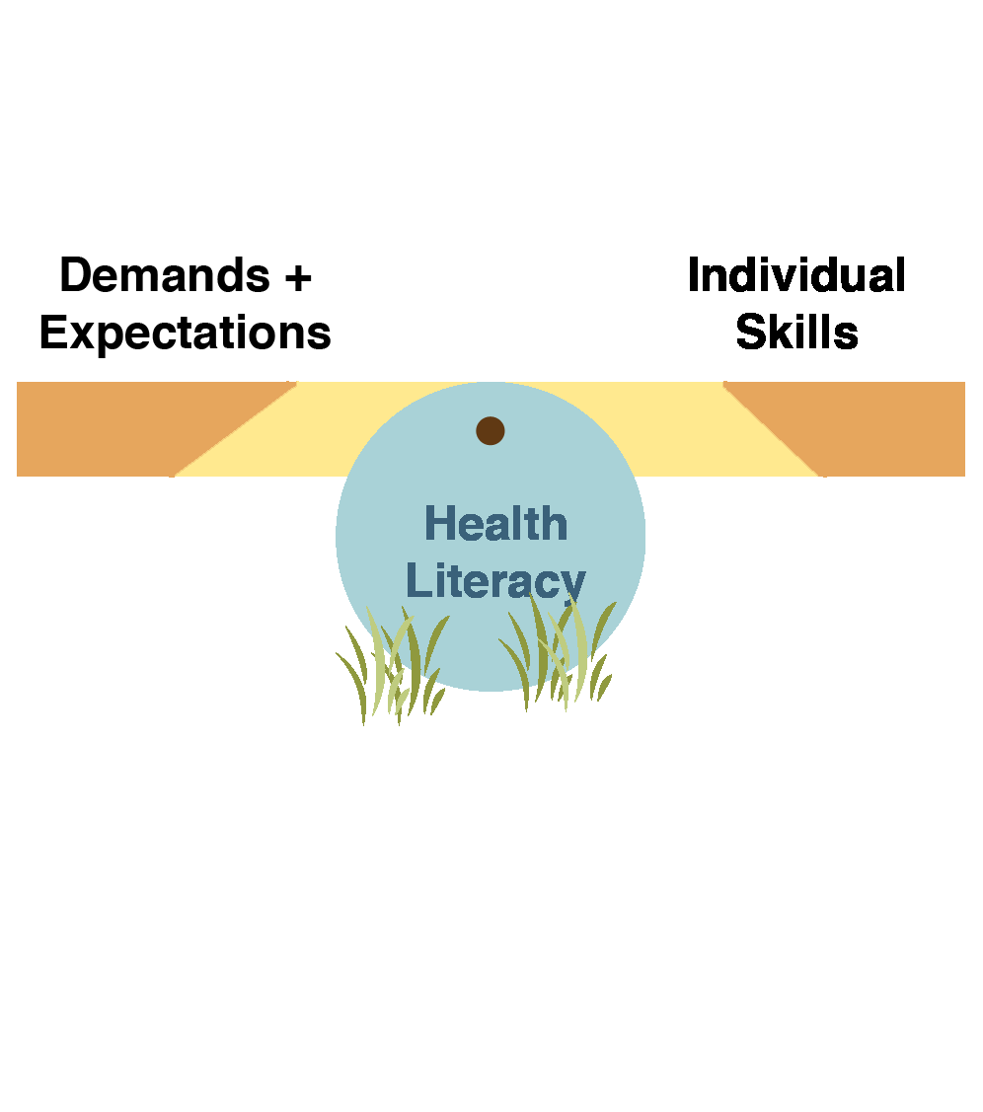
Solutions
(Coleman, et al., 2011-2017)
Notes:
From Alison’s slide

Slide 16

Plain Language Editing
Readability
Understanding
Ability to assess

Slide 17
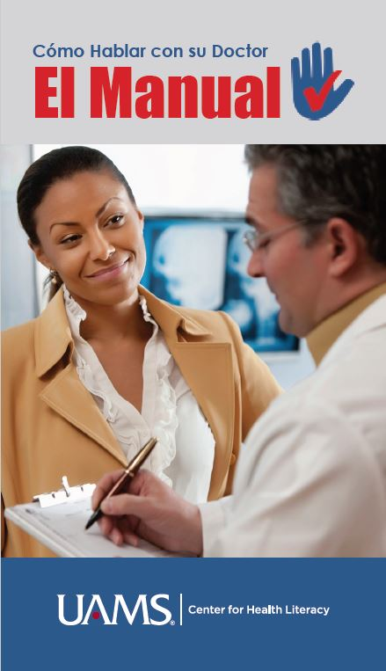

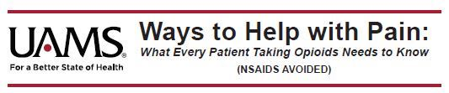
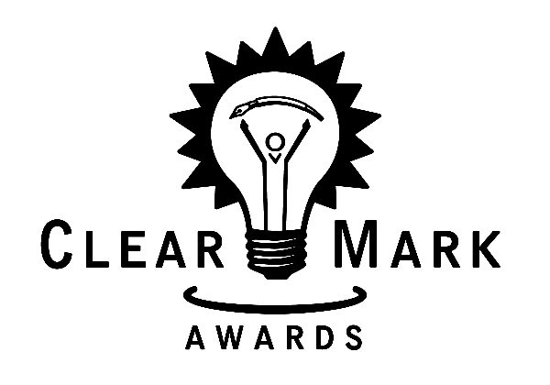
Materials Development
Notes:
Materials created by CHL

Slide 18
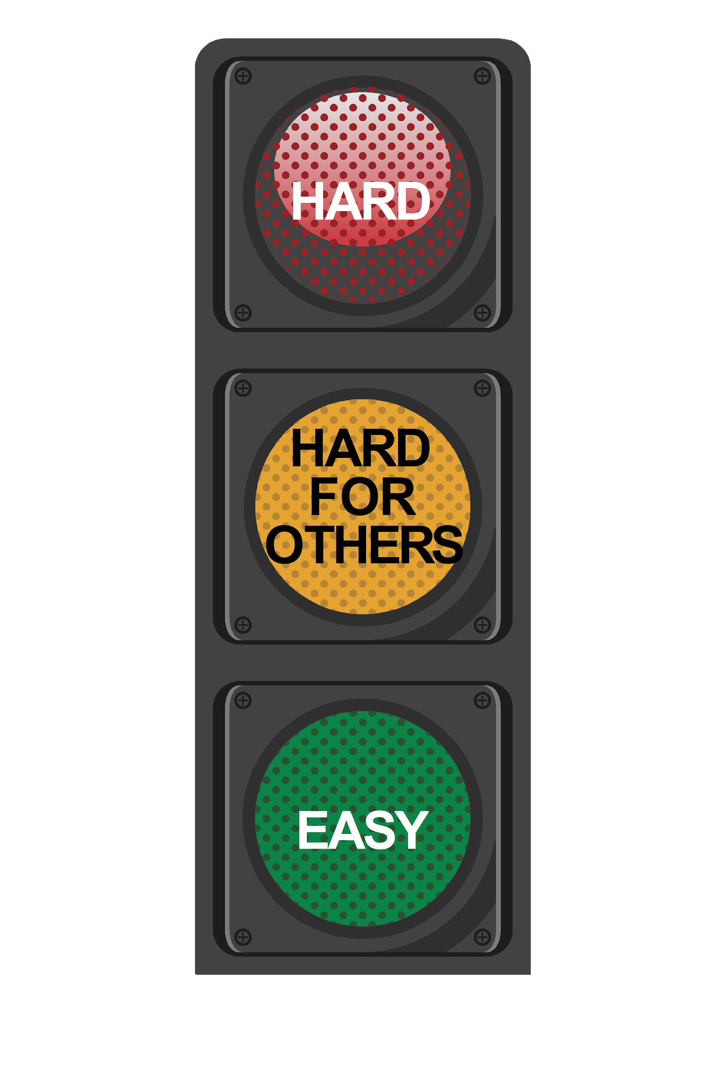

Field Testing
We have field tested:
Decision aid tool for chest pain
Plain language informed consent form
Handbooks (e.g. HTTTYD)
Patient education materials
(e.g. Falls, Cancer chemo regimens)
Notes:
We have field tested:
· Decision aid tool for chest pain
· Plain language informed consent form
· Handbooks: How to find out about your health, How to talk to your doctor, How to talk to your child’s doctor
· Patient ed materials for: Falls, How to deal with pain after surgery, cancer chemo regimens

Slide 19

Training

Slide 20
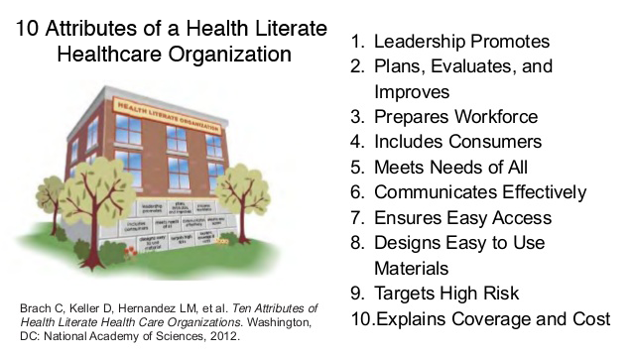
CDC. (2017). Attributes of a Health Literate Organization. https://www.cdc.gov/healthliteracy/planact/steps/index.html
Notes:
Source: CDC. (2017). Attributes of a Health Literate Organization. https://www.cdc.gov/healthliteracy/planact/steps/index.html
Consulting: Making your organization work.
AHRQ - 2 PCMH focal points: 1) self-management, 2) treatment adherence.

